Slide 1
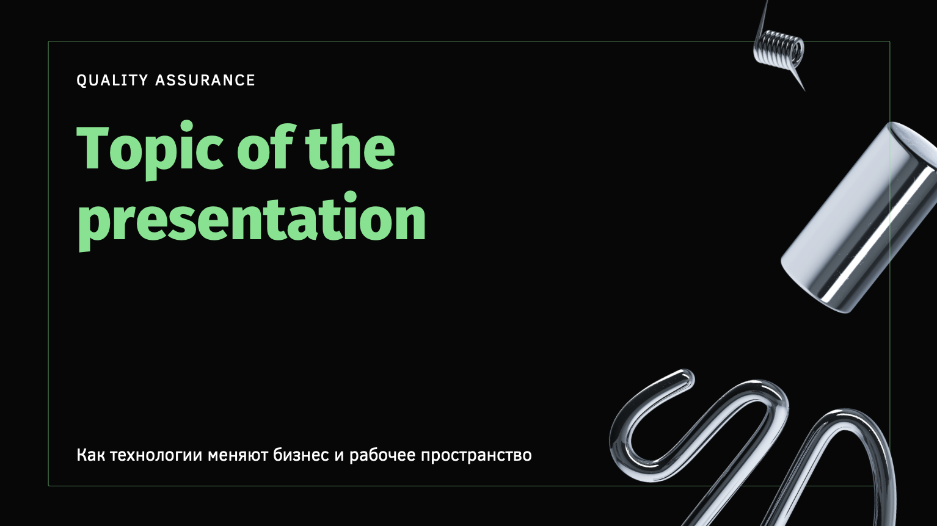
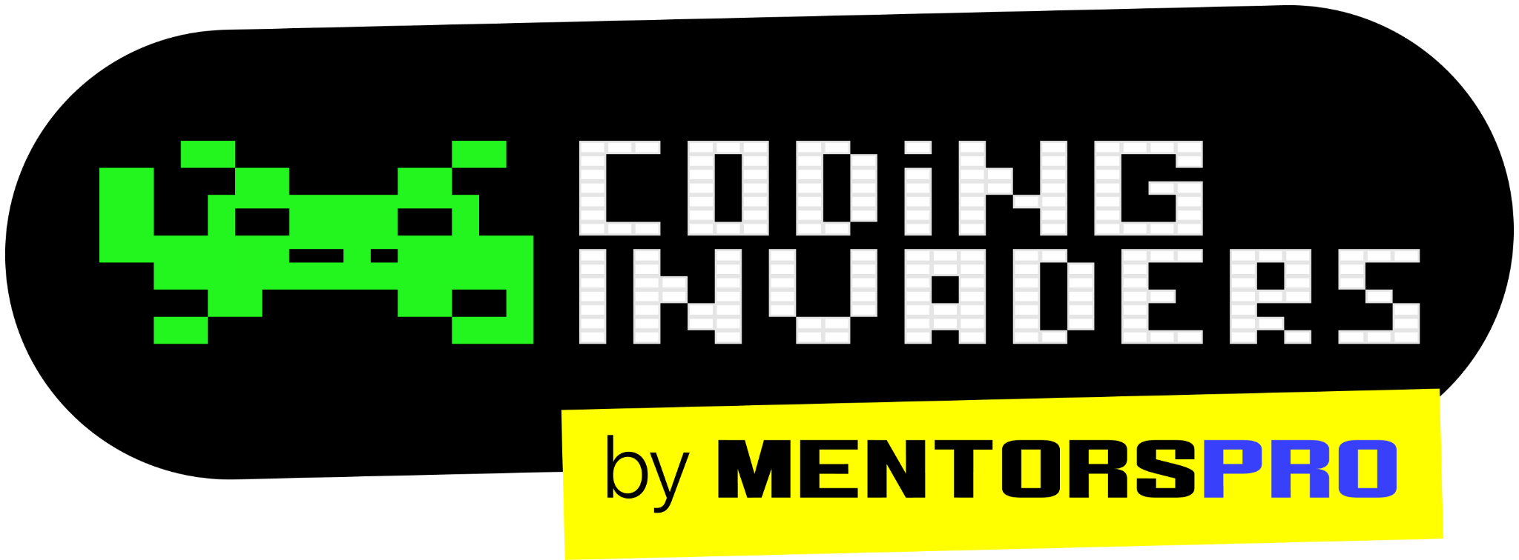
QA Automation Engineer
“ Agile ”
-By Manas
Content Title
Notes:
Title - Fira Sans, 50pt
Subtitle - Fira Sans, 16pt

Slide 2
Waterfall Model
Drawbacks of Waterfall Model
Agile Methodology
Waterfall vs Agile
Advantages of Agile
Agile
Notes:
Title - Fira Sans, 40pt
Other - Fira Sans, 16pt

Slide 3
Waterfall Model Waterfall model is an example of a Sequential model. In this model, the software development activity is divided into different phases and each phase consists of a series of tasks and has different objectives. It is divided into phases and output of one phase becomes the input of the next phase. It is mandatory for a phase to be completed before the next phase starts. In short, there is no overlapping in the Waterfall model

Slide 4
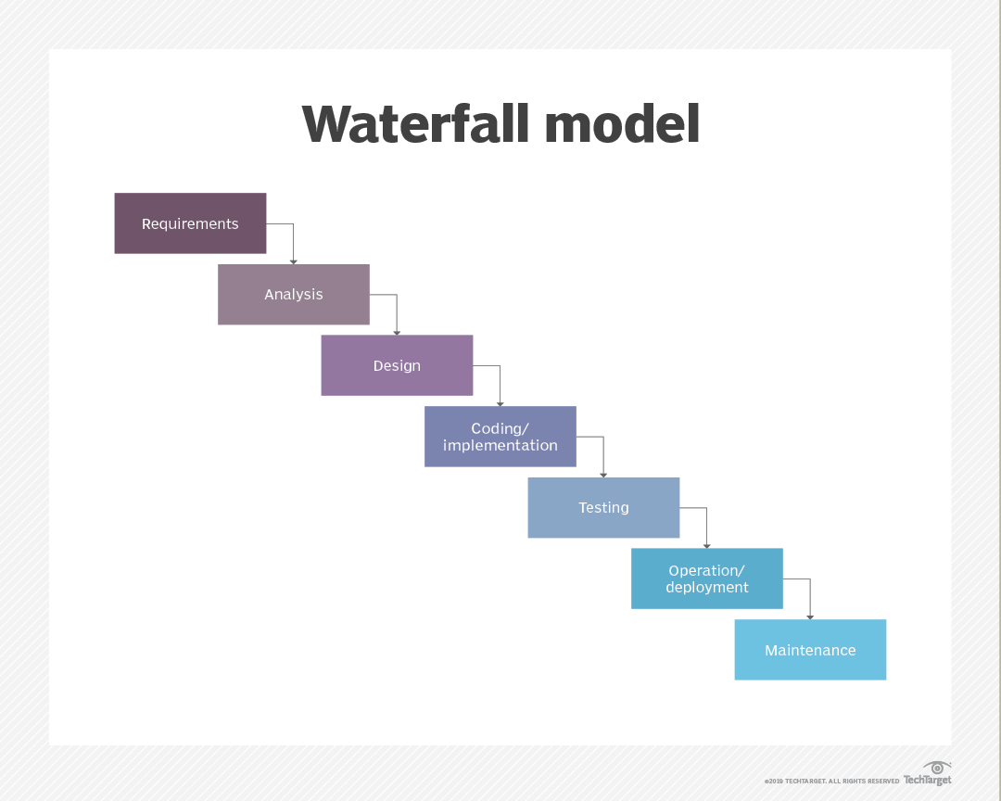

Slide 5
Disadvantages of Waterfall Model
It is difficult to estimate time and cost for each phase of the development process in waterfall model.
Once an application is in the testing stage, it is very difficult to go back and change something that was not well-thought-out in the concept stage.
Not a good model for complex and object-oriented projects.
It is difficult to measure progress within stages.
Cannot accommodate changing requirements.
Not suitable for the projects where requirements are at a moderate to high risk of changing.

Slide 6
Agile Methodology
Agile Methodology meaning a practice that promotes continuous iteration and incremental approach of development and testing throughout the software development lifecycle of the project. In the Agile model in software testing, both development and testing activities are concurrent, unlike the Waterfall model.
Agile software development allows the team to work together more efficiently and effectively in developing complex projects. It consists of practices that exercise iterative and incremental techniques which are easily adopted and display great results.

Slide 7
Advantages of Agile Methodology:
Customer satisfaction is rapid, continuous development and delivery of useful software.
Customer, Developer, QA, and Product Owner interact regularly to emphasize rather than processes and tools.
Product is developed fast and frequently delivered (weeks rather than months.)
A face-to-face conversation is the best form of communication.
It continuously gave attention to technical excellence and good design.
Daily and close cooperation between business people and development Team.
Regular adaptation to changing circumstances.
Even late changes in requirements are welcomed.

Slide 8
Agile Vs Waterfall
Agile methodology | Waterfall model
It follows the incremental approach. | It is a sequential design process.
It divides the project development lifecycle into a sprint. | The software development process is divided into distinct phases.
Agile methodology is a flexible methodology. | The Waterfall is a structured software development methodology.
Agile is the collection of many different projects. | It is completed as one single project.
The test plan is reviewed after each sprint | Test plan is reviewed after complete development.
Testing team can take part in the requirements change phase without problems. | It is difficult for the test to initiate any change in needs.

Slide 9
QA Automation Engineer
“ Scrum ”
-By Manas
Content Title
Notes:
Title - Fira Sans, 50pt
Subtitle - Fira Sans, 16pt

Slide 10
Types of Agile Methodology
Scrum Overview
Scrum Roles
Scrum Artifacts
Scrum Events/Ceremonies
Scrum
Notes:
Title - Fira Sans, 40pt
Other - Fira Sans, 16pt

Slide 11
Types Of Agile Methodology 1. Scrum 2. Kanban 3. Lean

Slide 12
Scrum
Scrum is a framework within which people can address complex adaptive problems, they will divide the work and delivering products of the highest possible value.
The Scrum framework consists of Scrum Teams and their associated roles, events, artifacts, and rules. Each component within the framework serves a specific purpose and is essential to Scrum’s success and usage.

Slide 13
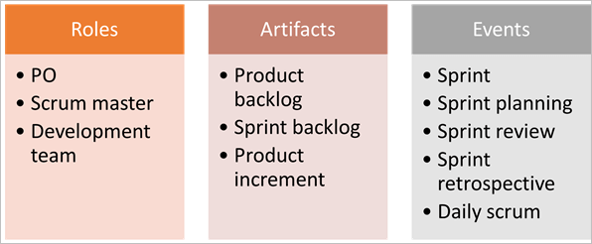
Scrum

Slide 14
Roles in Scrum
Product Owner
The product owner is the key stakeholder or the lead user of the application to be developed. The product owner is the person who represents the customer side. He/she has the final authority and should always be available for the team.
2. Scrum Master
Scrum Master is the facilitator of the scrum team. He/she makes sure that the scrum team is productive and progressive. In case of any impediments, scrum master follows up and resolves them for the team.
.

Slide 15
3. Business Analyst (BA)
A Business Analyst plays a very important role in SCRUM. This person is responsible for getting the requirement finalized and drafted in the requirement docs (based on which the user stories are created).
4. Development Team
Develop the Software based on Client requirement
5. Testing Team
Testing the Software

Slide 16
Scrum Artifacts:
Product Backlog
The product backlog is a kind of bucket or source where all the user stories are kept. This is maintained by the Product Owner. The product backlog can be imagined as a Wishlist of the product owner who prioritizes it as per the business needs.
Sprint Backlog
Based on the priority, user stories are taken from the Product Backlog as one at a time. The Scrum team brainstorms on it determines the feasibility and decides on the stories to work on a particular sprint. The collective list of all the user stories which the scrum team works on a particular sprint is known as Sprint backlog.

Slide 17
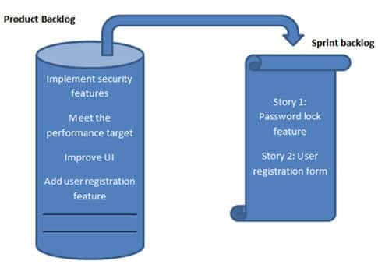
Product And Sprint Backlog

